Slide 1

INHERITANCE
PRESENTED BY
Julius. K
JK TUTORS
website; http://jktutors.com
email ; info@jktutors.com

Slide 2

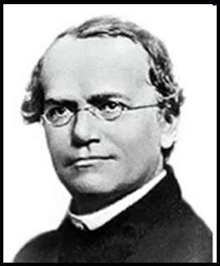
Mendel discovered the principles of inheritance with experiments in
which large numbers of pea plants were crossed.
Offspring inherit many traits from their parents, but the specific details of inheritance eluded scientists for centuries:
Early theories assumed a simple blending of
traits of the two parents…
Aristotle noticed that offspring sometimes looked more like one parent than the other – sometimes even more like a grandparent
In 1866, Gregor Mendel published his pea plant cross-breeding experiments that showed traits being inherited in specific patterns
His work was largely ignored until the early 1900s when it was rediscovered, replicated, and became the foundation for modern genetics

Slide 3
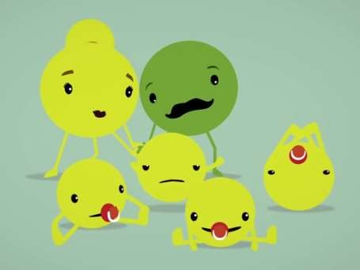
Mendel discovered the principles of inheritance with experiments in
which large numbers of pea plants were crossed.
Hybrid Parent Plant Cross | Offspring Phenotypes | Ratio
Tall stem x Dwarf stem | 787 Tall : 277 Dwarf | 2.84 : 1
Round seed x Wrinkled seed | 5474 Round : 1850 Wrinkled | 2.96 : 1
Yellow peas x Green peas | 6022 Yellow : 2001 Green | 3.01 : 1
Purple flowers x White flowers | 705 Purple : 224 White | 3.15 : 1
Mendel noticed that certain versions of a trait, such as tall height, round seeds, yellow color, and purple flowers would always show-up in a cross with a purebred plant – He called these DOMINANT versions of the gene, or ALLELE
Other versions of the trait only showed up in
hybrid crosses or when the ‘dominant trait’ was not present in either parent – He called these the RECESSIVE alleles
http://ed.ted.com/lessons/how-mendel-s-pea-plants- helped-us-understand-genetics-hortensia-jimenez-diaz

Slide 4
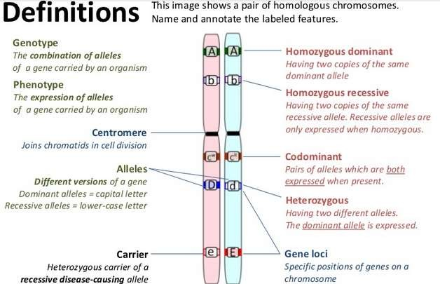
Mendel discovered the principles of inheritance with experiments in
which large numbers of pea plants were crossed.

Slide 5
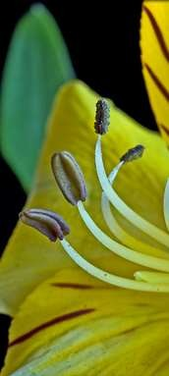
    Gametes are haploid so contain one allele of each gene / 3.4.4 Fusion of gametes results in diploid zygotes with two alleles of each gene that may be the same allele or different alleles
Gametes are haploid and contain one copy of each chromosome – and therefore one allele of each gene:
When the male and female gametes fuse in fertilization, the resultant diploid cell – called the Zygote – will have two alleles of each gene, one from each parent
Many genes have two alleles, as Mendel observed – often one is dominant, one recessive, producing three possible genotypes:
      AA = Homozygous Dominant (dominant phenotype)
      Aa = Heterozygous (dominant phenotype)
      aa = Homozygous Recessive (recessive phenotype)

Slide 6
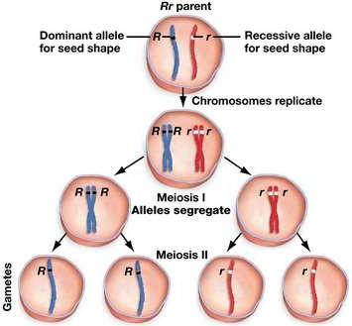
The two alleles of each gene separate into different haploid daughter
nuclei during meiosis
Since Meiosis involves a reduction division, each haploid gamete gets only one of the two alleles that a parent has for each gene. Which allele each sex cell receives is random (i.e. if the father is heterozygous for a gene, half of his sperm will contain the dominant allele and the other half will have the recessive)

Slide 7

Dominant alleles mask the effects of recessive alleles but co-dominant
alleles have joint effects
Dominant alleles always show their encoded trait, when present in an organism (they mask recessive alleles)
Recessive alleles only express their encoded traits when no other alleles are present
Dominant alleles code for functional proteins, while recessive alleles code for non- functional proteins
Codominant alleles can have joint effects if both are
present*
*Patterns of inheritance, like Codominance, that do not follow Mendel’s
observations are called Non-Mendelian inheritance patterns.

Slide 8
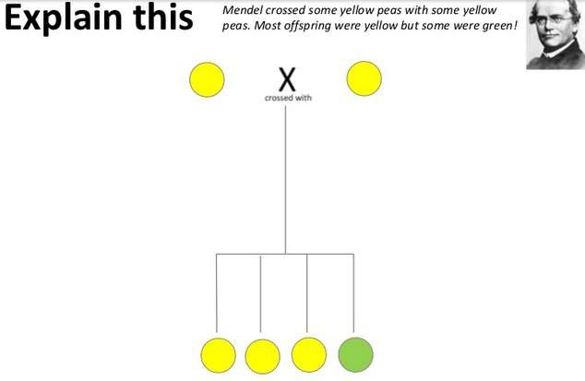
Construct Punnett grids (squares) for predicting the outcomes of
monohybrid genetic crosses.

Slide 9
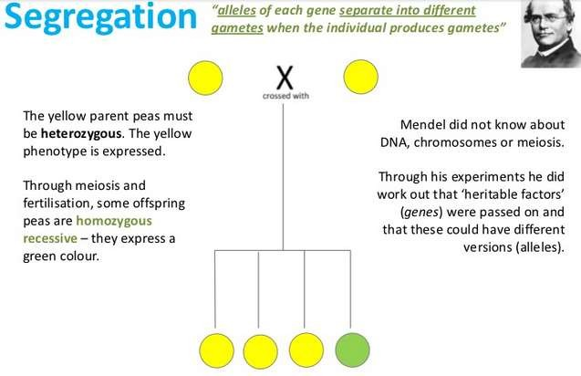
Construct Punnett grids (squares) for predicting the outcomes of
monohybrid genetic crosses.

Slide 10
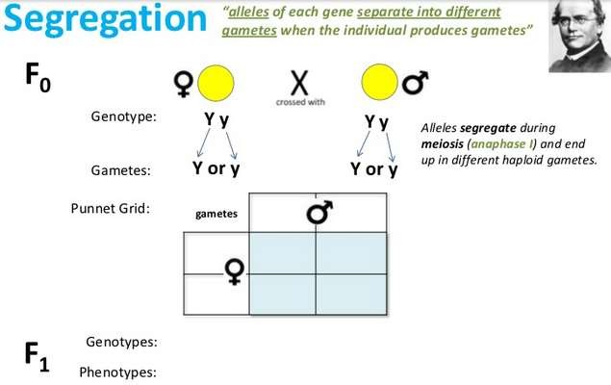
Construct Punnett grids (squares) for predicting the outcomes of
monohybrid genetic crosses.

Slide 11
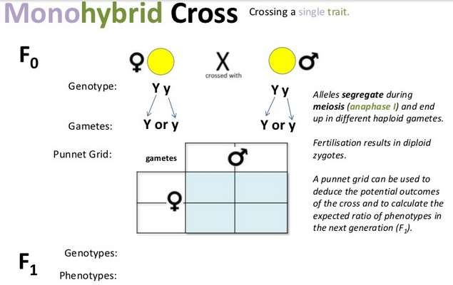
Construct Punnett grids (squares) for predicting the outcomes of
monohybrid genetic crosses.

Slide 12
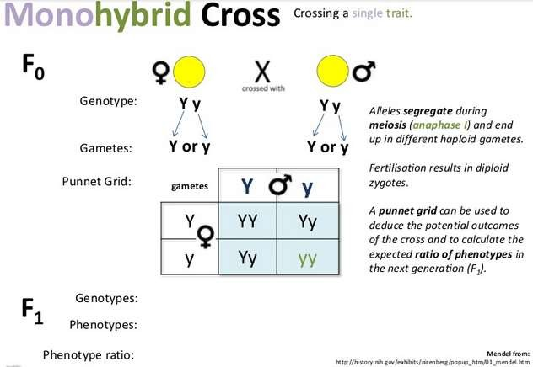
Construct Punnett grids (squares) for predicting the outcomes of
monohybrid genetic crosses.

Slide 13
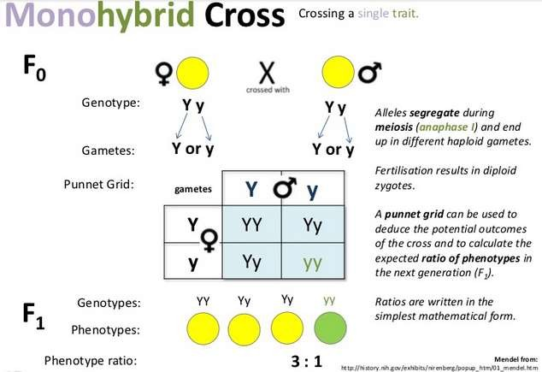
Construct Punnett grids (squares) for predicting the outcomes of
monohybrid genetic crosses.

Slide 14
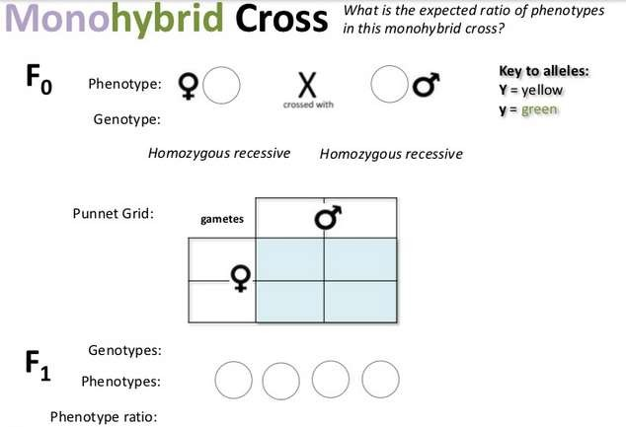
Construct Punnett grids (squares) for predicting the outcomes of
monohybrid genetic crosses.

Slide 15
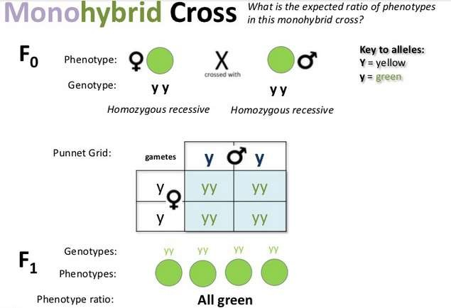
Construct Punnett grids (squares) for predicting the outcomes of
monohybrid genetic crosses.

Slide 16

Construct Punnett grids (squares) for predicting the outcomes of
monohybrid genetic crosses.

Slide 17
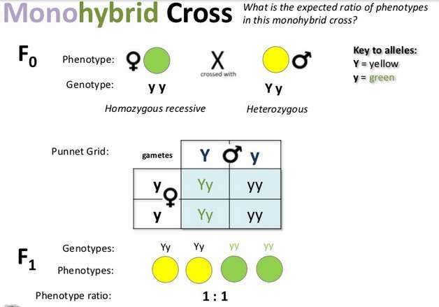
Construct Punnett grids (squares) for predicting the outcomes of
monohybrid genetic crosses.

Slide 18
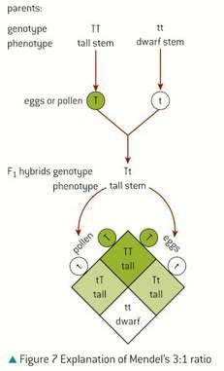
Construct Punnett grids (squares) for predicting the outcomes of
monohybrid genetic crosses.
A Mendelian monohybrid cross:
F1 Parent Genotypes: Tt x Tt
F1 Parent Phenotypes: Tall x Tall
Offspring Genotype Ratio:
1 : 2 : 1
(TT : Tt : tt)
Offspring Phenotype Ratio:
3 : 1 (Tall : Dwarf)*
*Just as Mendel observed!

Slide 19
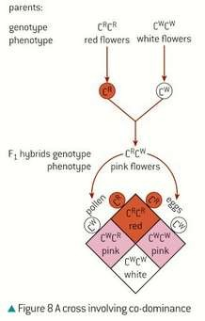
Construct Punnett grids (squares) for predicting the outcomes of
monohybrid genetic crosses.
A Non-Mendelian monohybrid cross:
F1 Parent Genotypes: C^{R}C^{W} x C^{R}C^{W}
F1 Parent Phenotypes: Pink x Pink
Offspring Genotype Ratio:
1 : 2 : 1
(C^{R}C^{R} : C^{R}C^{W} : C^{W}C^{W})
Offspring Phenotype Ratio:
1 : 2 : 1
(Red : Pink : White)
R

Slide 20

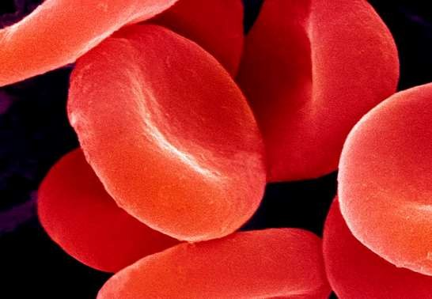
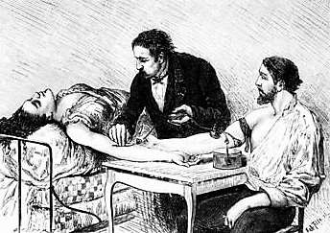
Inheritance of ABO blood groups
When surgeons started performing human blood transfusions in the mid-1800s, they were a very risky procedure. Doctors noticed that sometimes the blood transfusion was successful, while other times the transfused blood clumped up (clotted) inside the patient and killed them.
It was not until the early 1900s that scientists discovered humans have different glycoproteins on their red blood cells that give them different blood types. Since the immune system only recognizes certain blood types, the immune cells of patients who got mismatched blood would attack and destroy the ‘foreign’ cells, causing clots.

Slide 21
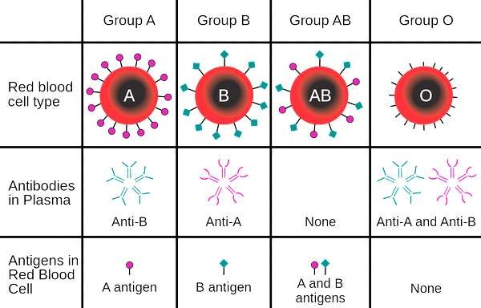
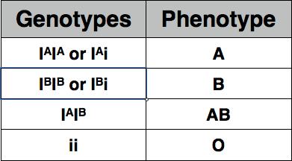
Inheritance of ABO blood groups
In humans, ABO blood group is determined by a single gene on Chromosome 9. ABO blood type is an example of ‘Multiple Alleles’ and Codominance:
The gene has three alleles:
I^{A} : glycoprotein with A antigen (codominant) I^{B} : glycoprotein with B antigen (codominant) i : normal glycoprotein (recessive)

Slide 22
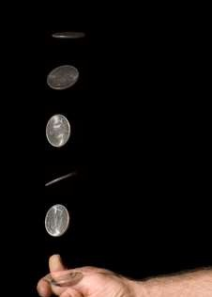
Comparison of predicted and actual outcomes of genetic crosses using
real data
Mendel’s experiments and Reginald Punnett’s models allow for the prediction of genetic outcomes in offspring.*
*Mendel’s actual data were so close to perfect 3:1 predicted ratios that many esteemed scientists and mathematicians have proposed that he might have
manipulated is results
However, predictions do not always match actual outcomes. For example, a coin tossed 100 times does not always produce 50 heads and 50 tails since each flip is a random event
With this in mind, scientists can collect large amounts of data to reduce the impact of such random fluctuations – The Law of Large Numbers (i.e. 10,000 coin flips will show a closer to 50-50 split than 10 flips)
Scientists can also use statistical tests like the T-test and the Chi-Squared test to determine if results are significant, or due to random chance!

Slide 23
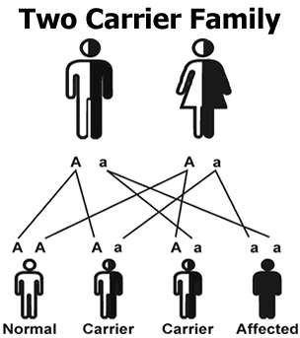
Many genetic diseases in humans are due to recessive alleles of
autosomal genes
NOTE: An autosomal gene is a gene whose loci is on an autosome, not a sex chromosome
A genetic disease is a disorder caused by a gene, rather than microbes. In most cases, a mutated allele causes a protein to be altered which impairs normal cell / body function – we have already seen an example of this in Sickle Cell Anemia
Most disease-causing alleles are recessive – meaning an individual must inherit both copies of the disease allele to actually have the disorder
Individuals can be carriers for these genetic disorders, meaning they ‘carry’ one copy of the recessive disease allele and one dominant allele that gives them a normal phenotype.

Slide 24
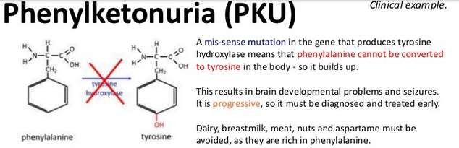
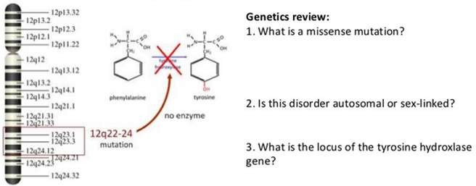
Many genetic diseases in humans are due to recessive alleles of
autosomal genes

Slide 25
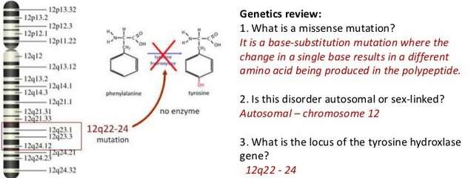
Many genetic diseases in humans are due to recessive alleles of
autosomal genes

Slide 26
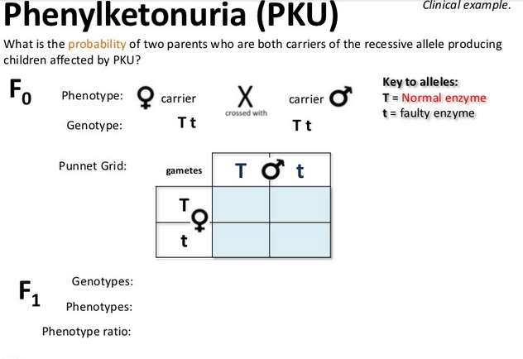
Many genetic diseases in humans are due to recessive alleles of
autosomal genes

Slide 27
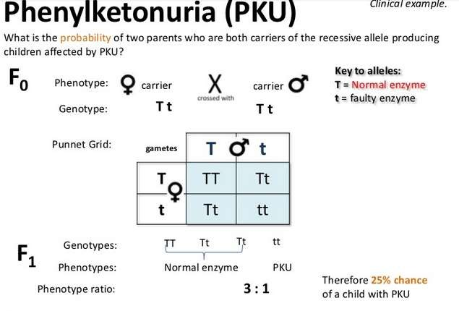
Many genetic diseases in humans are due to recessive alleles of
autosomal genes

Slide 28
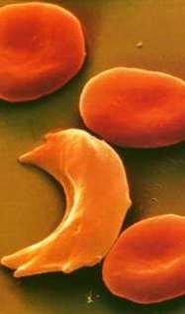
Some genetic diseases are sex-linked and some are due to dominant or
co-dominant alleles
Huntington’s disease is caused by an autosomal dominant allele:
  Inheriting just one mutated allele will
cause this deadly neurological condition
Sickle Cell Anemia is caused by autosomal codominant alleles:
  Hb^{A} Hb^{A} = Normal phenotype
  Hb^{A} Hb^{S} = Mild anemia phenotype with
malaria resistance
  Hb^{S} Hb^{S} = Full sickle cell phenotype
Color-blindness is caused by a recessive allele on the X sex chromosome (so the gene is said to be ‘sex linked’):
  Since males only get one copy, they are more likely to express the colorblind phenotype (a female would need to inherit two colorblind alleles to show this trait)

Slide 29
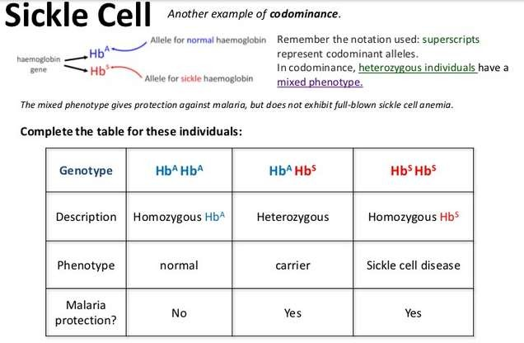
Some genetic diseases are sex-linked and some are due to dominant or
co-dominant alleles

Slide 30
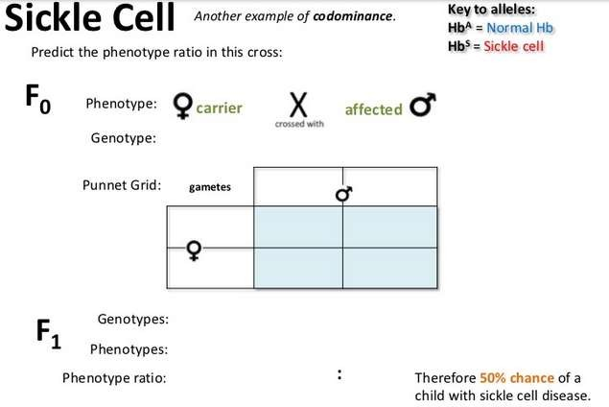
Some genetic diseases are sex-linked and some are due to dominant or
co-dominant alleles

Slide 31
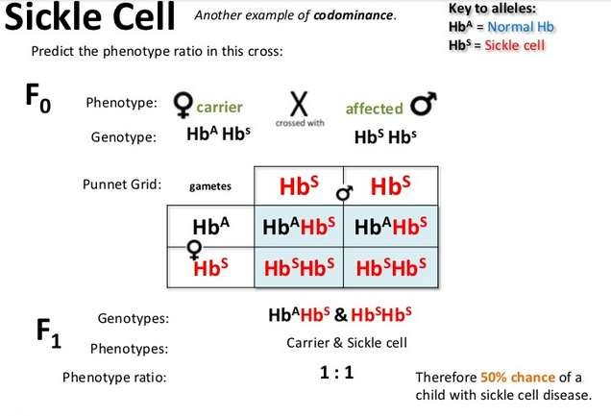
Some genetic diseases are sex-linked and some are due to dominant or
co-dominant alleles

Slide 32
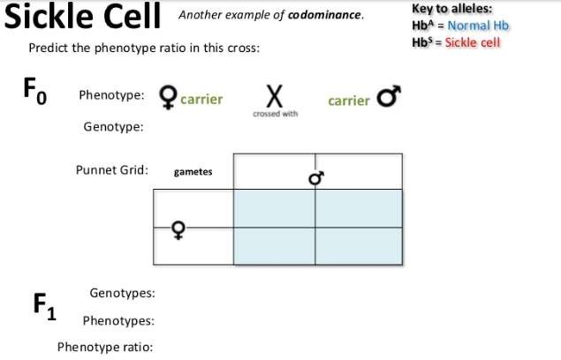
Some genetic diseases are sex-linked and some are due to dominant or
co-dominant alleles

Slide 33
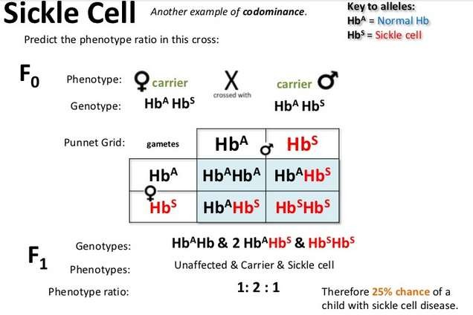
Some genetic diseases are sex-linked and some are due to dominant or
co-dominant alleles

Slide 34
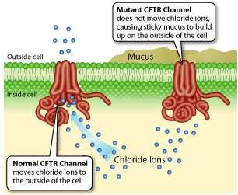
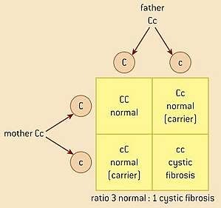
Inheritance of cystic fibrosis and Huntington’s disease
Cystic Fibrosis
An autosomal recessive genetic disease caused by a mutation of the CFTR gene on Chromosome 7
The CFTR gene encodes the production of a chloride membrane channel protein involved in secretion of sweat, mucus, and digestive juices
The mutated, disease allele produces a non-functional membrane protein that causes sticky mucus builds up in the lungs, causing infection

Slide 35
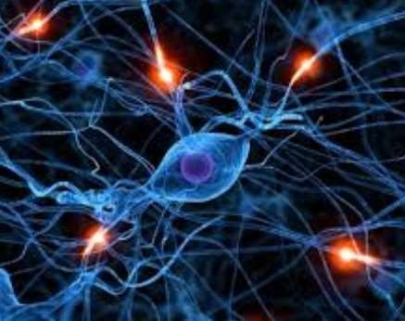
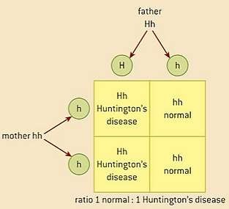
Inheritance of cystic fibrosis and Huntington’s disease
Huntington’s Disease
An autosomal dominant genetic disease caused by a mutation of the HTT gene on Chromosome 4
The function of the normal huntingtin protein is still being studied, but the dominant allele causes progressive neurodegeneration beginning between ages 30 and 50.
Life expectancy is ~20 years after the onset of
symptoms.
Due to the late-onset nature, most parents have already had children before they become symptomatic…

Slide 36
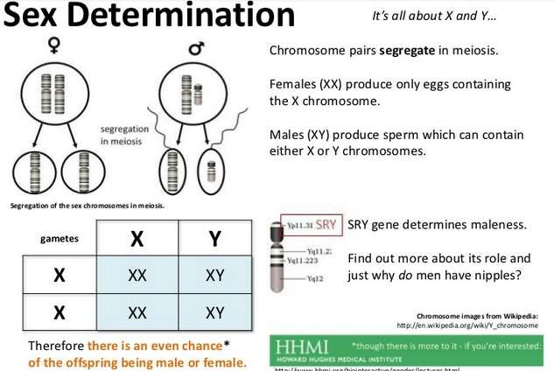
The pattern of inheritance is different with sex-linked genes due to
their location on sex chromosomes.

Slide 37
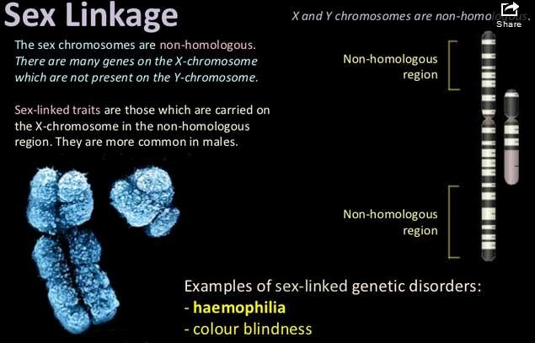
The pattern of inheritance is different with sex-linked genes due to
their location on sex chromosomes.

Slide 38
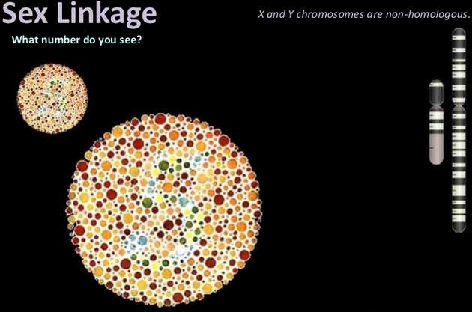
Red-green color-blindness and hemophilia as examples of sex-linked
inheritance

Slide 39
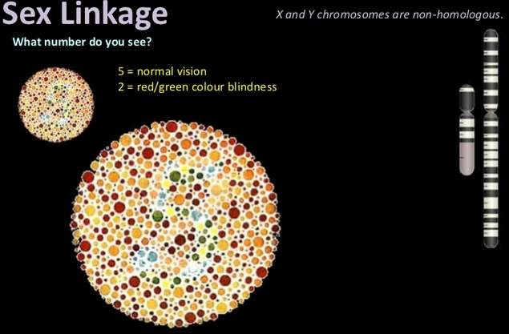
Red-green color-blindness and hemophilia as examples of sex-linked
inheritance

Slide 40
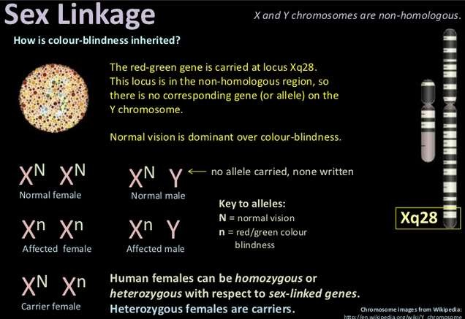
Red-green color-blindness and hemophilia as examples of sex-linked
inheritance

Slide 41
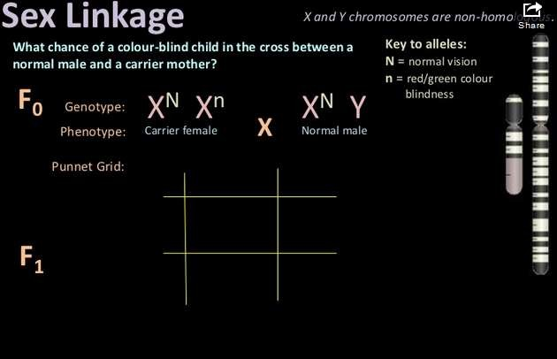
Red-green color-blindness and hemophilia as examples of sex-linked
inheritance

Slide 42
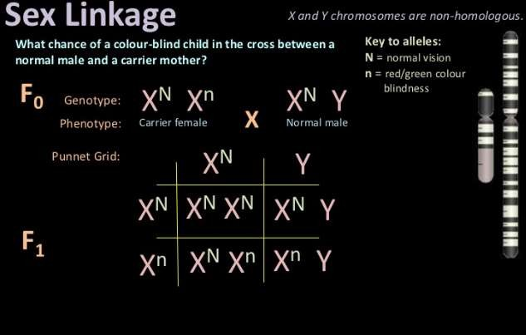
Red-green color-blindness and hemophilia as examples of sex-linked
inheritance

Slide 43
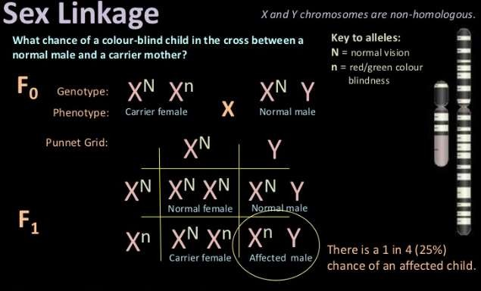
Red-green color-blindness and hemophilia as examples of sex-linked
inheritance

Slide 44
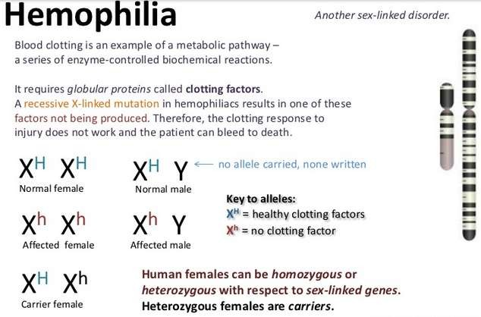
Red-green color-blindness and hemophilia as examples of sex-linked
inheritance

Slide 45
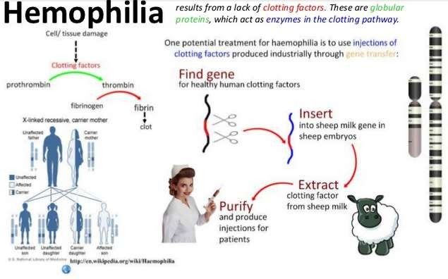
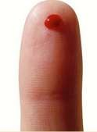
Red-green color-blindness and hemophilia as examples of sex-linked
inheritance

Slide 46
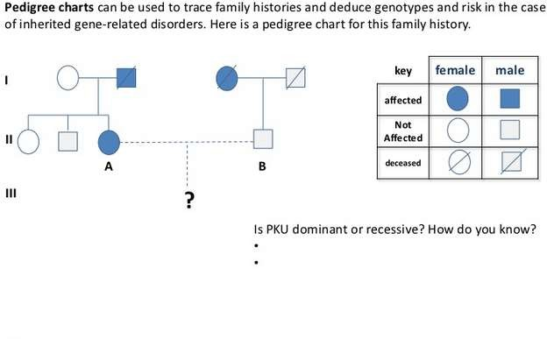
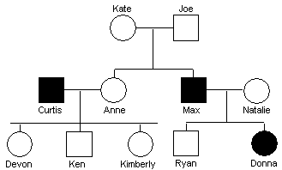
genetic diseases
Analysis of pedigree charts to deduce the pattern of inheritance of
The basics of Pedigrees:
Sex of Individual:
  Male = Square
  Female = Circle
Presence of Trait:
  Shading = Affected
  Unshaded = Unaffected
  Half-shade = Carrier
Rows represent generations
Autosomal Dominant or Recessive?
  Recessive
Genotype of Max? (AA, Aa, or aa)
  aa
Genotype of Ryan? (AA, Aa, or aa)
  Aa

Slide 47



Analysis of pedigree charts to deduce the pattern of inheritance of
genetic diseases
Sex-Linked, Recessive:
Trait is able to skip generations
Males are predominantly affected
Autosomal, Recessive:
Trait is able to skip generations
No major sex-bias in expression
Autosomal, Dominant:
Trait cannot skip generations
No major sex-bias in expression

Slide 48

Analysis of pedigree charts to deduce the pattern of inheritance of
genetic diseases

Slide 49

Analysis of pedigree charts to deduce the pattern of inheritance of
genetic diseases

Slide 50

Analysis of pedigree charts to deduce the pattern of inheritance of
genetic diseases

Slide 51

Analysis of pedigree charts to deduce the pattern of inheritance of
genetic diseases

Slide 52

Analysis of pedigree charts to deduce the pattern of inheritance of
genetic diseases

Slide 53



Analysis of pedigree charts to deduce the pattern of inheritance of
genetic diseases
Medical researchers have identified more than
4,000 human genetic diseases so far.
Examples to know include Cystic fibrosis, Huntington’s disease, Sickle cell anemia, and Hemophilia
Yet most people are unaffected by genetic diseases because most are caused by very rare, recessive alleles
Today, cheap and fast genetic tests can allow parents to determine if they carry genetic diseases before they make decisions about having children

Slide 54

Radiation and mutagenic chemicals increase the mutation rate and
can cause genetic disease and cancer.
Alleles for a gene differ by just a few nitrogen base letters (SNPs). New alleles are formed by mutation – a random change in the base sequence of a gene
High-energy radiation, including Gamma rays, UV
light, and X-rays, can increase mutation rate
Some chemicals – called mutagens – can also increase mutation rate, such as mustard gas in WWI and chemicals in tobacco smoke
Mutations in oncogenes (genes that regulate the cell cycle) can lead to cancer
Mutations in genes of gametes can be passed on to children, possibly causing a genetic disease

Slide 55

Nagasaki and the nuclear accident at Chernobyl.
Consequence of radiation after nuclear bombing of Hiroshima and
The Bombing of Hiroshima & Nagasaki
Massive release of high-energy, radioactive isotopes into the environment
150,000 – 250,000 people died directly or within a few months of the bombing of the two Japanese cities in 1945
Long-term survivors showed slightly higher rates of tumor formation but no statistically- significant increase in fetal mutations

Slide 56

Nagasaki and the nuclear accident at Chernobyl.
Consequence of radiation after nuclear bombing of Hiroshima and
The Chernobyl Nuclear Accident
Massive release of high-energy, radioactive isotopes into the environment – 400 times more than Hiroshima!
1986 – Nuclear reaction explodes
in Chernobyl, Ukraine
All plant workers quickly killed by fatal does of radiation and clouds of radioactive isotopes were spread across Europe

Slide 57

Nagasaki and the nuclear accident at Chernobyl.
Consequence of radiation after nuclear bombing of Hiroshima and
The Chernobyl Nuclear Accident
Effects of nuclear fallout:
Miles of forest land killed, including most animals and plants
Lynx, owls, wild boar, and other select species began to thrive in the ‘exclusion zone’
Bioaccumulation caused high levels of radioactive isotopes in fish as far away as Germany and Scandinavia
More than 6,000 cases of thyroid
cancer attributed to accident

Slide 58

Nagasaki and the nuclear accident at Chernobyl.
Consequence of radiation after nuclear bombing of Hiroshima and
The Chernobyl Nuclear Accident
Scientists estimate that the ‘Exclusion Zone’
– 19 square miles of land around the former power plant – will not be safe for human habitation again for 20,000 years…

