Slide 1

Origin of cells
PRESENTED BY
Julius. K
JK TUTORS
website; http://jktutors.com
email ; info@jktutors.com

Slide 2
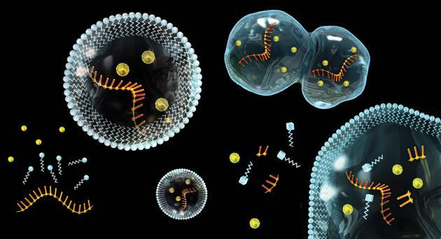
Origin of cells
Essential idea: There is an unbroken chain of life from the first cells on Earth to all cells in organisms alive today.
Edited by Eran Earland
Acknowledgements to Chris Paine and Bioninja
https://bioknowledgy.weebly.com/
http://rstb.royalsocietypublishing.org/content/361/1470/1023/F3.large.jpg

Slide 3
Understandings, Applications and Skills
 | Statement | Guidance
 | Cells can only be formed by division of pre-existing cells. | Students should be aware that the 64 codons in the genetic code have the same meanings in nearly all organisms, but that there are some minor variations that are likely to have accrued since the common origin of life on Earth.
 | The first cells must have arisen from non-living material.
 | The origin of eukaryotic cells can be explained by the endosymbiotic theory. | Evidence for the endosymbiotic theory is expected. The origin of eukaryote cilia and flagella does not need to be included.
 | Evidence from Pasteur’s experiments that spontaneous generation of cells and organisms does not now occur on Earth.

Slide 4
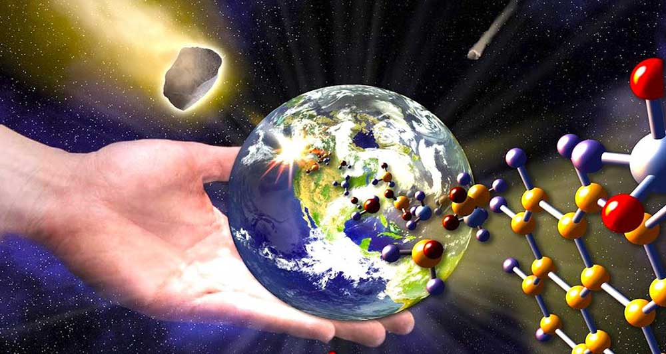
Pre-Biotic Evolution – Extra info

Slide 5
Pre-Biotic Evolution – Extra info
The initial formation of primitive living structures (protocells) is thought to require a specific supporting chemical environment
Early Earth had a chemically-reducing atmosphere, which when exposed to energy in various forms (heat, electrical discharge, etc.) produced a variety of simple organic compounds (monomers)
These compounds accumulated in a molecular ‘soup’, allowing for the formation of more complex compounds (polymers)

Slide 6
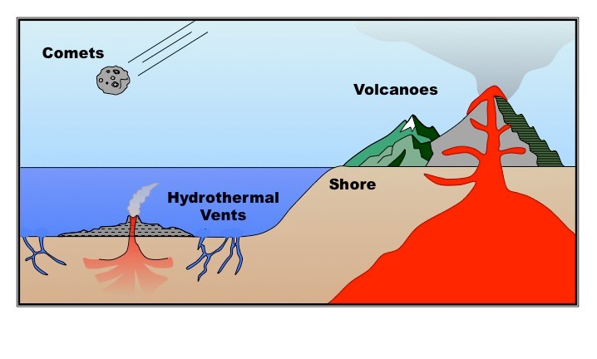
Pre-Biotic Evolution – Extra info
There are a number of locations posited as providing suitable conditions for the formation of a concentrated chemical soup, including volcanoes, hydrothermal vents, shorelines and outer space

Slide 7
Pre-Biotic Evolution – Extra info
1. Volcanoes
The gas composition of volcanic eruptions contain high levels of fixed nitrogen and other raw materials which could be used for primitive metabolism
Intensive volcanic activity could also generate sufficient thermal energy to catalyse the formation of organic molecules
2. Hydrothermal Vents
Hydrothermal vents are regions of the ocean floor where superheated water is released from the Earth’s crust
These vents also release hydrogen-rich fluids to create a chemical gradient and pH viable for organic synthesis

Slide 8
Pre-Biotic Evolution – Extra info
3. Shorelines
Organic life may have evolved at a sea shore or other region where there is an alternation of wet and dry conditions
The drying of clay particles could have precipitated catalysing reactions needed for the formation of organic molecules
4. Extraterrestrial Origins
The necessary conditions required for the formation of life may have initially been derived on other planets (e.g. Mars)
Comets contain a variety of organic material (~20% of a comet’s tail is comprised of organic matter)
Heavy meteorite bombardment approximately 4 billion years ago may have delivered organic material to the Earth
The theory that life on Earth was initially seeded in space or on another planet is called panspermia

Slide 9
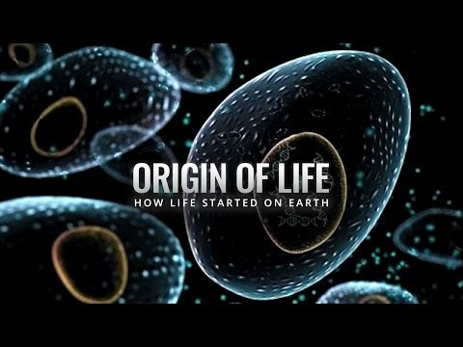
Pre-Biotic Evolution – Extra info

Slide 10
RNA Pre-Biotic Evolution
The RNA world hypothesis proposes that a world filled with RNA-based life predates current DNA-based lifeforms
RNA has two key qualities that would have allowed it to function in this manner:
RNA can self-replicate
RNA is able to store information in a sequence composed of four recurring nucleotides (similar to DNA)
Short sequences of RNA are able to be accurately duplicated to form identical RNA molecules
RNA can act as a catalyst
Modern cells use RNA catalysts (called ribozymes) to remove introns from mRNA and help synthesise new RNA molecules
In ribosomes, rRNA functions as the catalytic component and plays a pivotal role in peptide bond formation

Slide 11
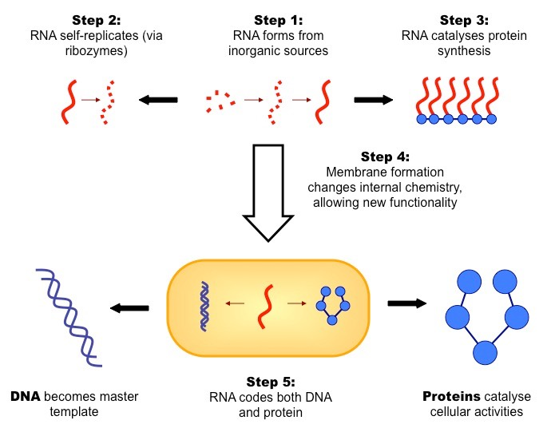
RNA Pre-Biotic Evolution – Links to Topic 2
RNA is the only molecule that is capable of both self-replication and catalytic functioning, but has since been superseded:
DNA, through its superior chemical stability (double helical structure) has taken over as the data storage form
Protein, through its greater variability (20 amino acids as opposed to 4 nucleotide bases) has taken over as the catalytic form
RNA remains as a transitional form between DNA and protein, suggestive of its multi-faceted origins

Slide 12
Evolution of Life & Oxygen –
Primordial Earth had a reducing atmosphere that contained very low levels of oxygen gas
After about ~2 billion years of prokaryotic life, a form of chlorophyll evolved in prokaryotes (forming cyanobacteria)
This allowed for the process of photosynthesis to occur, creating oxygen gas as a by-product via the photolysis of water
The increase in oxygen in the atmosphere was coupled to a number of significant effects:
There was a breakdown of chemicals in the atmosphere and oceans to produce oxidized compounds (e.g. CO₂)
There was an evolution of organisms capable of breaking down oxygen-rich oxidizing agents (e.g. aerobes)
The subsequent formation of an ozone layer restricted UV radiation to allow for the proliferation of a wider range of life forms

Slide 13
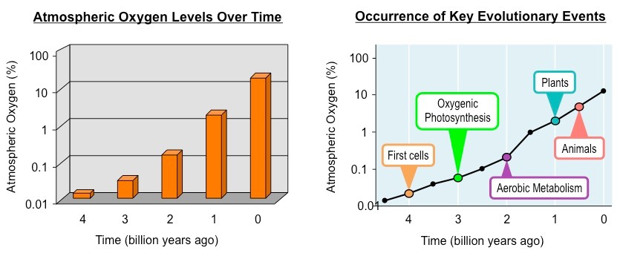
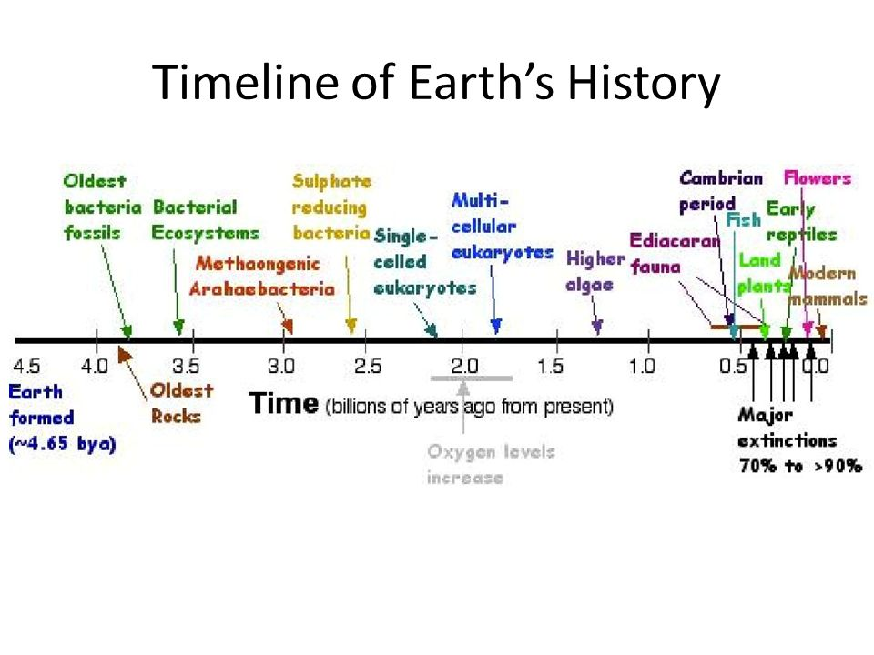
Evolution of Life & Oxygen –

Slide 14
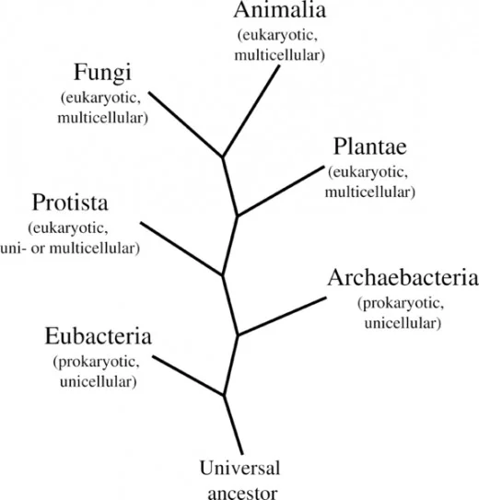
Evolution of Life & Oxygen –

Slide 15
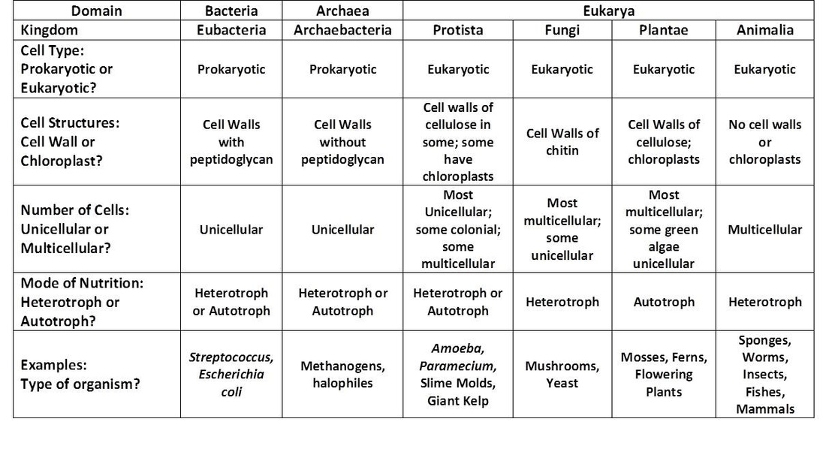
Kingdoms and Domains of Life –

Slide 16
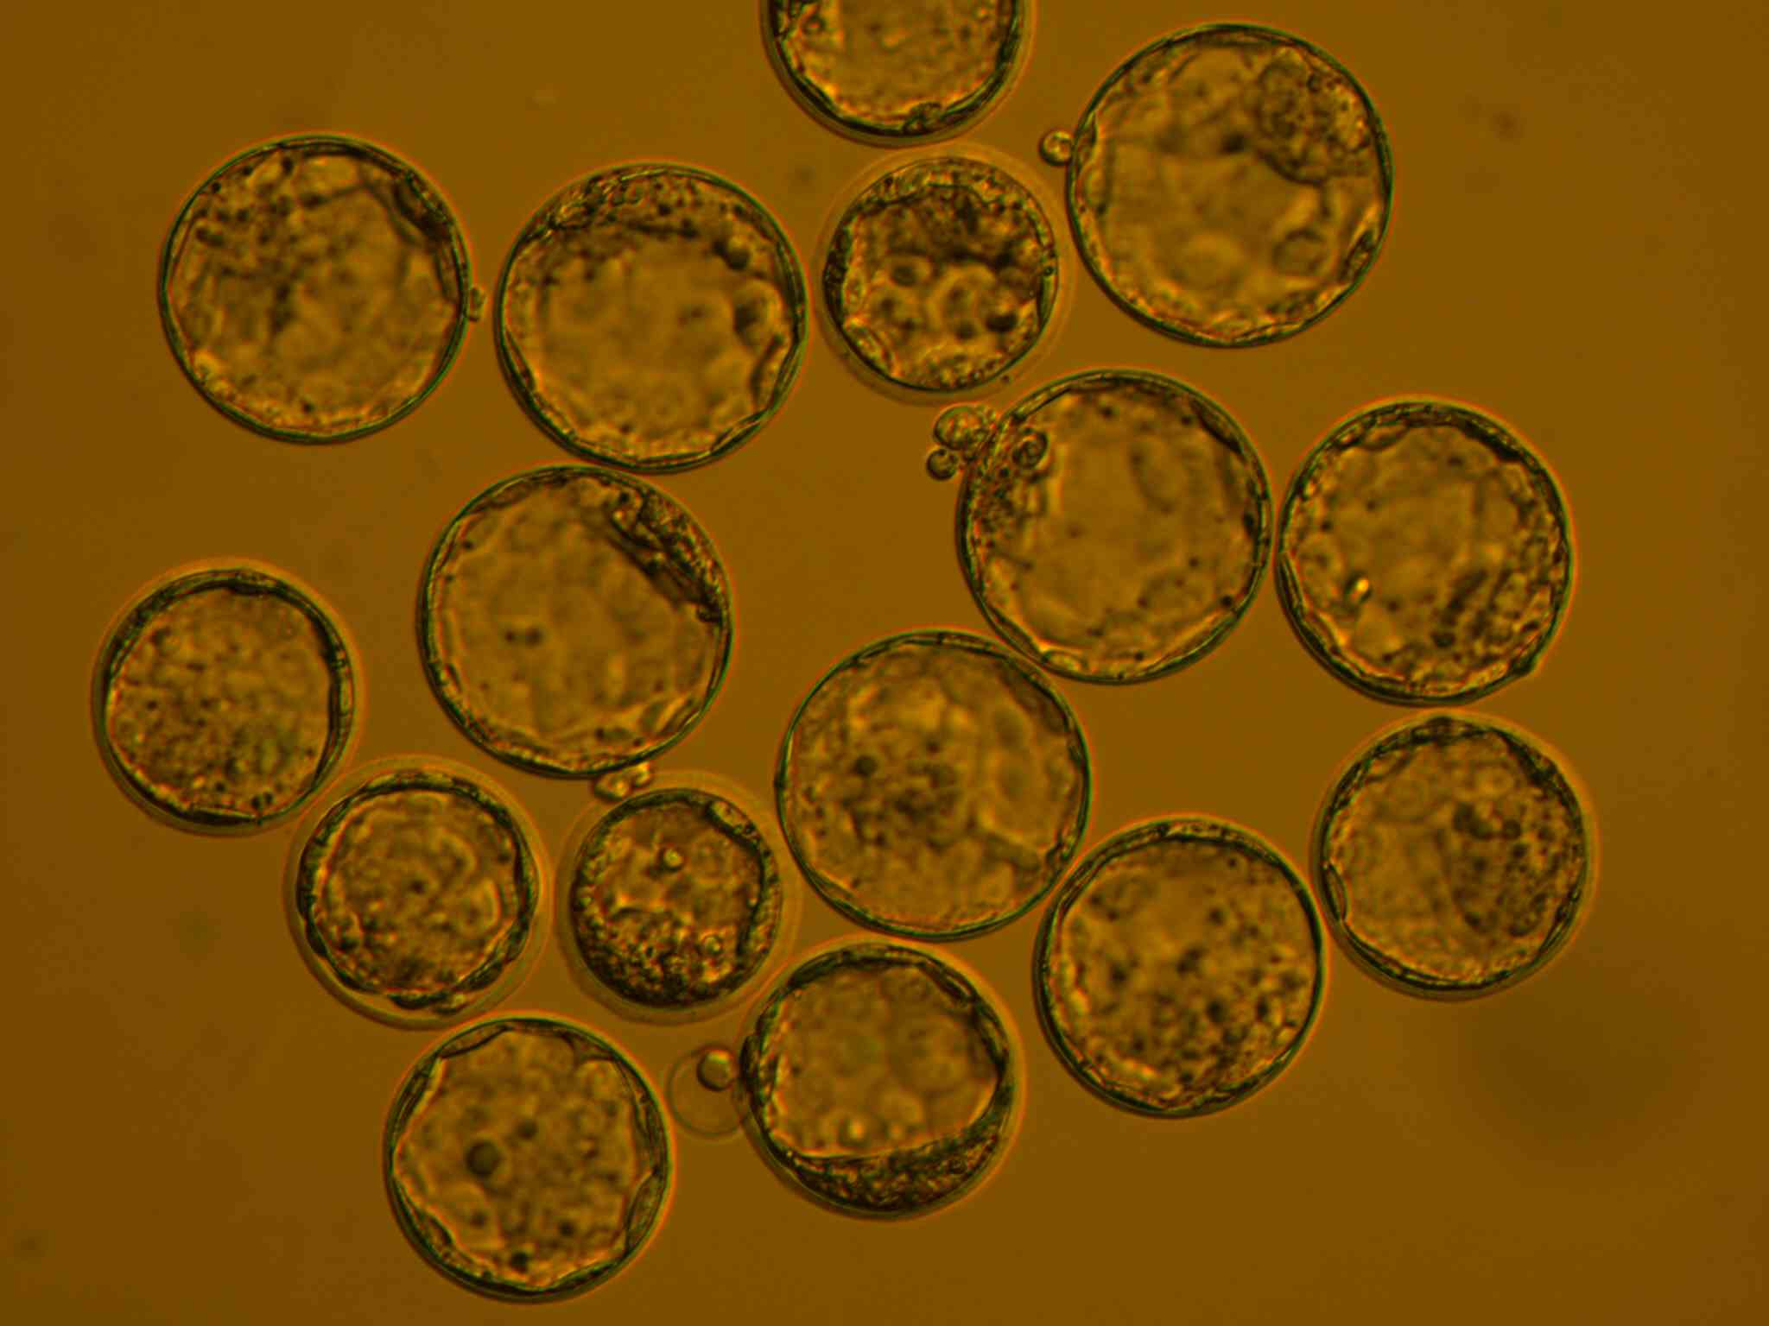
According to the cell theory, living organisms are composed of cells.
Remember this theory from 1.1 Introduction to cells?
Cell theory states that:
All living things are composed of cells (or cell products)
The cell is the smallest unit of life
Cells only arise from pre-existing cells
Source: http://www.engr.uconn.edu/alarm/research?id=63

Slide 17
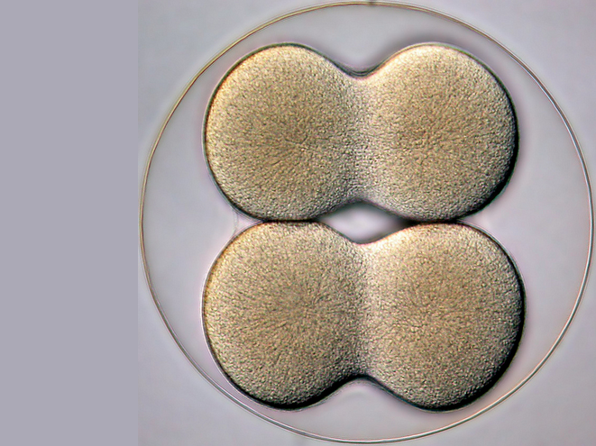
Cells can only be formed by division of pre-existing cells.
Cells can only be formed by division of pre-existing cells:
Cells multiply through division
  Mitosis results in genetically identical diploid daughter cells
  Meiosis generates haploid gametes (sex cells)
4-cell stage of a sea biscuit by Bruno Vellutini on Flickr (CC) http://flic.kr/p/daWnnS

Slide 18
Cells can only be formed by division of pre-existing cells.
What evidence do we have (other than Pasteur’s experiments) to support this theory?
4-cell stage of a sea biscuit by Bruno Vellutini on Flickr (CC) http://flic.kr/p/daWnnS

Slide 19
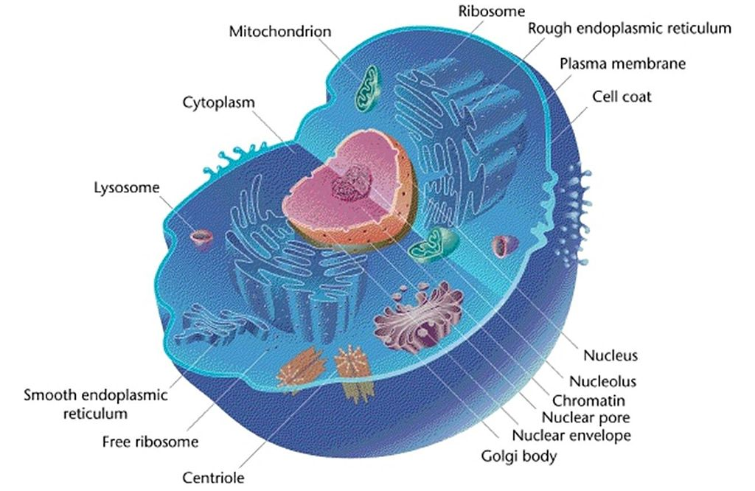
Cells can only be formed by division of pre-existing cells.
1. Cells are highly complex structures and no mechanism has been found for producing cells from simpler subunits.
http://upload.wikimedia.org/wikipedia/commons/thumb/3/3e/Eukaryotic_Cell_%28animal%29.jpg/1024px-Eukaryotic_Cell_%28animal%29.jpg

Slide 20
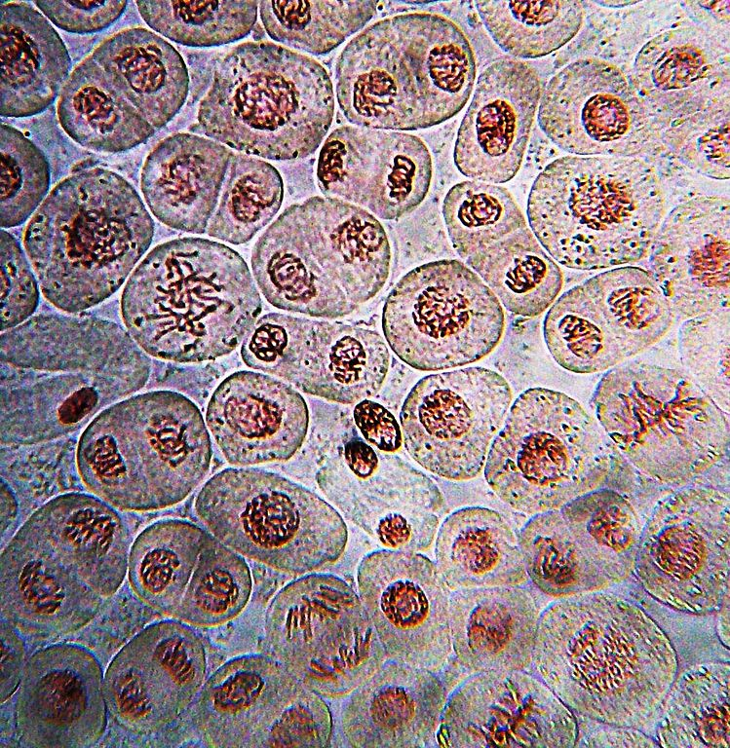
Cells can only be formed by division of pre-existing cells.
2. All known examples of growth be it of a tissue, an organism or a population, are all a result of cell division.
http://upload.wikimedia.org/wikipedia/commons/thumb/d/d3/Onion_root_mitosis.jpg/749px-Onion_root_mitosis.jpg

Slide 21
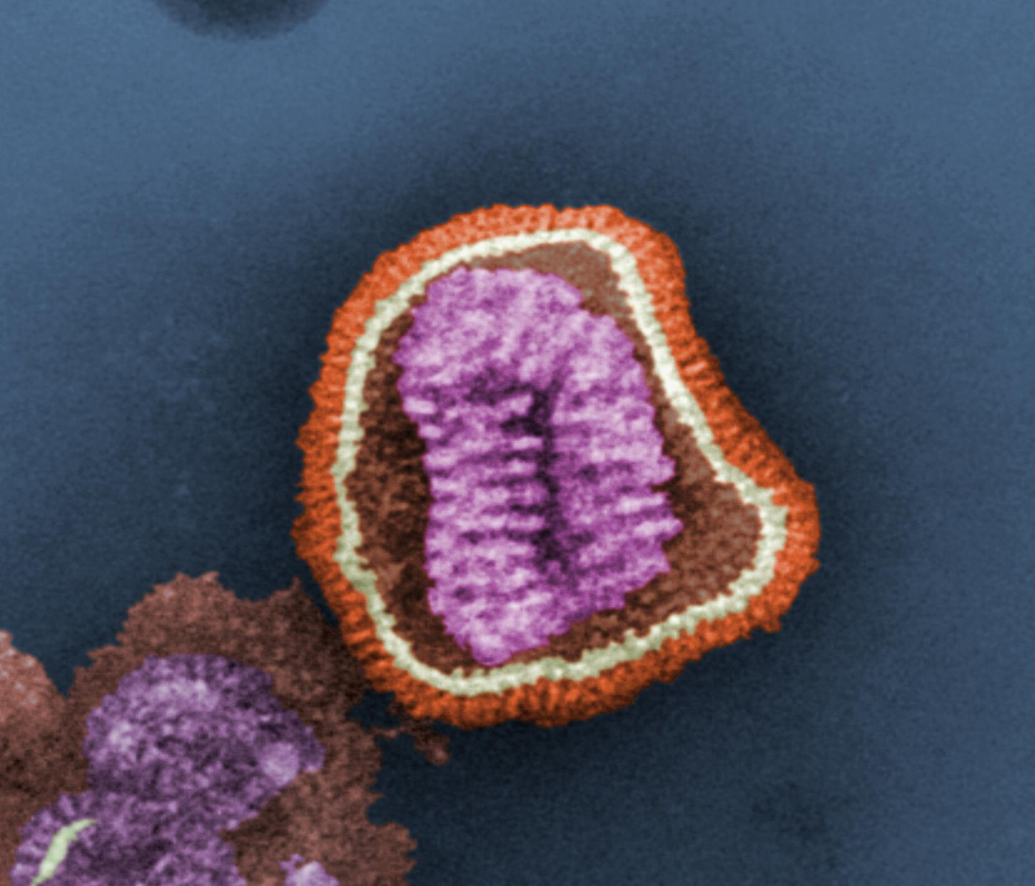
1.5.U1 Cells can only be formed by division of pre-existing cells.
3. Viruses are produced from simpler subunits, but they do not consist of cells, and they can only be produced inside the host cells that they have infected.
http://upload.wikimedia.org/wikipedia/commons/3/3a/Influenza_virus_particle_color.jpg

Slide 22
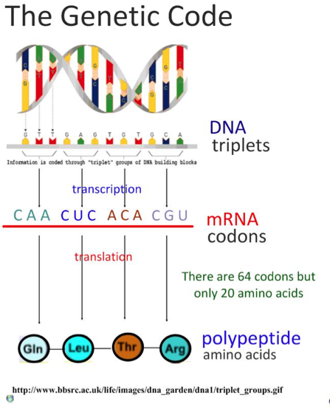
Cells can only be formed by division of pre-existing cells.
4. Genetic code is universal each of the 64 codons (a codon is a combination of 3 DNA bases) produces the same amino acid in translation, regardless of the organism *.
The logical deduction is that all cells have arisen as the result of cell division from a single common ancestor.
There are some minor variations that are likely to have accrued since the common origin of life on Earth, but these are rare and most of the genetic code is universal most of the time.
http://www.slideshare.net/gurustip/protein-synthesis-35-transcription-translation-sl

Slide 23
The first cells must have arisen from non-living material.
If we accept that there were times in the history of the Earth when cells did not exist then it is an obvious point that ‘The first cells must have arisen from non-living material’. The only other possible explanation is that life, in the form of cells, was transported here from elsewhere in the universe. As illustrated above, it is extremely difficult (and given our level of technology currently impossible), to generate cells from anything but other cells. So how did the first cells arise?
Some of the key problems are:
Non-living synthesis of simple organic molecules, e.g. sugars and amino acids
Assembly of these organic molecules into polymers
Formation of polymers that can self-replicate (enabling inheritance)
Formation of membranes to package the organic molecules
Read page
48-49
In Textbook
http://exploringorigins.org/resources.html

Slide 24
The first cells must have arisen from non-living material.
The theory that living cells arose from non-living matter is known as abiogenesis
This process is theorized to have occurred over four key stages:
There was non-living synthesis of simple organic molecules (from primordial inorganic molecules)
These simple organic molecules became assembled into more complex polymers
Certain polymers formed the capacity to self-replicate (enabling inheritance)
These molecules became packaged into membranes with an internal chemistry different from their surroundings (protobionts)
http://exploringorigins.org/resources.html

Slide 25
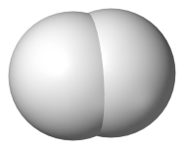
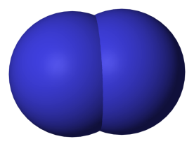
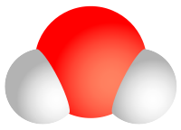
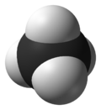
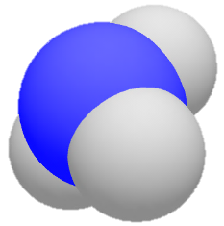
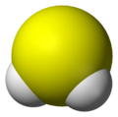

The first cells must have arisen from non-living material.
Earth’s atmosphere was ‘reducing’ in the early days. It did not contain oxygen gas until after plants started photosynthesising
Can you identify these molecules?
All molecules public domain from Wikimedia Commons, Background image http://www.flickr.com/photos/lrargerich/4587244190/

Slide 26
The first cells must have arisen from non-living material.
Earth’s atmosphere was ‘reducing’ in the early days. It did not contain oxygen gas until after plants started photosynthesising
The atmosphere contained: Hydrogen
Nitrogen
Water vapour
Methane
Ammonia
Hydrogen sulfide
The gases came from abundant volcanic activity
All molecules public domain from Wikimedia Commons, Background image http://www.flickr.com/photos/lrargerich/4587244190/

Slide 27
The first cells must have arisen from non-living material.
These monomers mixed in the ‘primeval soup’, shallow oceans laden with chemicals
where it is thought that they reacted to form biological molecules
Miller and Urey tried to recreate these conditions in the lab in 1953
They were trying to demonstrate ‘chemical evolution’, the formation of more complex
molecules from simpler stock in the primeval soup
They combined the molecules from the previous page in a closed glass vessel
(simulated atmosphere), they heated the water (simulated volcanic activity) and
sparked electricity through the gases (simulated lightning)
http://www.flickr.com/photos/afeman/663646181/

Slide 28
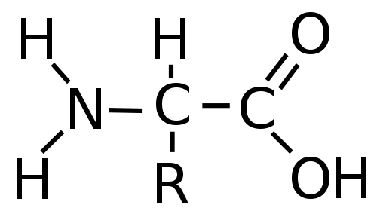
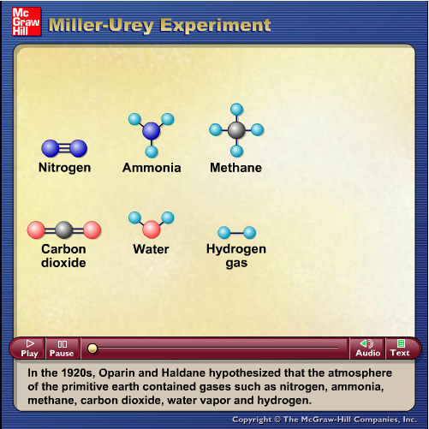
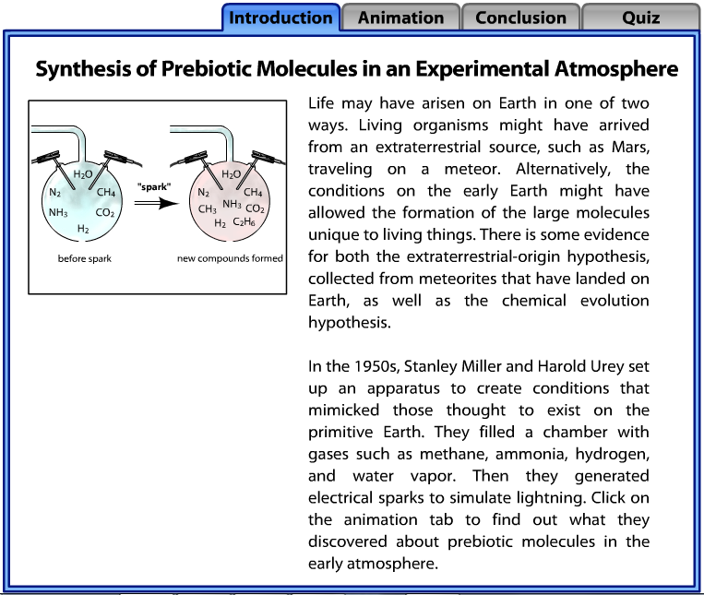
The first cells must have arisen from non-living material.
After a week they found:
Thirteen of the twenty naturally occurring amino acids
Around 15% of the carbon was now in organic compounds

Slide 29
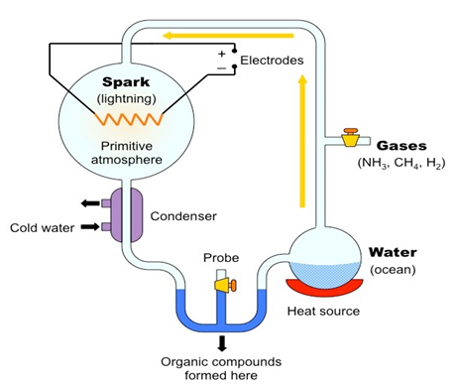

The first cells must have arisen from non-living material.
1. Non-living synthesis of simple organic molecules:
Miller and Urey recreated the conditions of pre-biotic Earth in a closed system.
These conditions included a reducing atmosphere (low oxygen), high radiation levels, high temperatures and electrical storms
Water was boiled to form vapour and then was mixed with methane, ammonia and hydrogen
The mixture of gases was exposed to an electrical discharge (sparks) to simulate lightning
The mixture was then allowed to cool and after one week was found to contain some simple amino acids and complex oily hydrocarbons
Based on these findings, it was concluded that under the hypothesised conditions of pre-biotic Earth, organic molecules could be formed
Carny http://upload.wikimedia.org/wikipedia/commons/5/59/MUexperiment.png

Slide 30
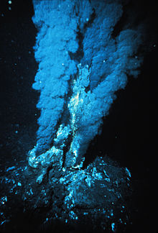
The first cells must have arisen from non-living material.
2. Assembly of these organic molecules into polymers:
Miller and Urey’s experiments allowed for the formation of amino acids, but the conditions used also tended to hydrolyse bonds preventing polymers forming.
Deep-sea thermal vents
Fissures in a planet's surface from which geothermally heated water issues. Vents are commonly found near in volcanically active areas)
Along with heat energy the Vents issue a ready supply of reduced inorganic chemicals
Vents provide the right conditions and chemicals to allow organic polymers to arise.
http://upload.wikimedia.org/wikipedia/commons/thumb/6/6f/Blacksmoker_in_Atlantic_Ocean.jpg/220px-Blacksmoker_in_Atlantic_Ocean.jpg

Slide 31
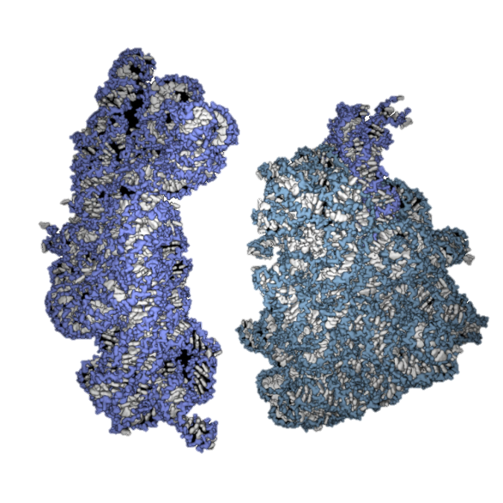
The first cells must have arisen from non-living material.
3. Formation of polymers that can self-replicate (enabling inheritance)
DNA though very stable and effective at storing information is not able to self-replicate – enzymes are required
However RNA can both store information and self-replicate - it can catalyse the formation of copies of itself.
In ribosomes RNA is found in the catalytic site and plays a role in peptide bond formation
http://exploringorigins.org/resources.html
For more detail research the RNA World Hypothesis

Slide 32
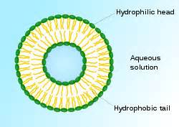
The first cells must have arisen from non-living material.
4. Formation of membranes to package the organic molecules
Experiments have shown that phospholipids natural assemble into bilayers, if conditions are correct.
Formation of the bilayer creates an isolated internal environment.
The formation of an internal environment means that optimal conditions, e.g. for replication or catalysis can be maintained.
http://upload.wikimedia.org/wikipedia/commons/thumb/0/01/Liposome_scheme-en.svg/220px-Liposome_scheme-en.svg.png

Slide 33
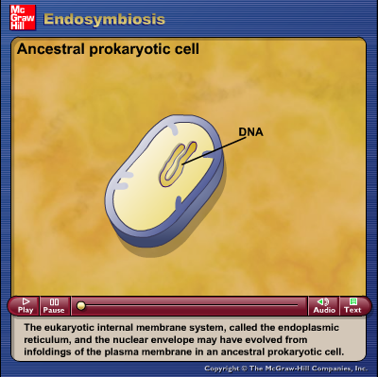
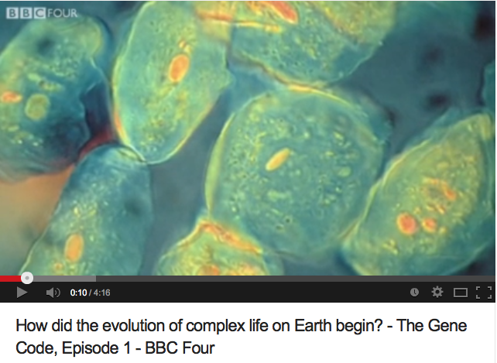
The origin of eukaryotic cells can be explained by the endosymbiotic theory.
Endosymbiotic theory explains the existence of several organelles of eukaryotes. The theory states that the organelles (e.g. mitochondria and chloroplasts) originated as symbioses between separate single-celled organisms,
Use the video and/or the tutorial to understand how this occurred.
http://youtu.be/q71DWYJD-dI
http://highered.mcgraw-hill.com/sites/9834092339/student_view0/chapter26/animation_-_endosymbiosis.html

Slide 34
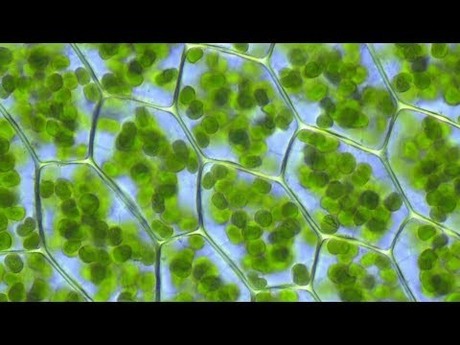
The origin of eukaryotic cells can be explained by the endosymbiotic theory.
An endosymbiont is a cell which lives inside another cell with mutual benefit
Eukaryotic cells are believed to have evolved from early prokaryotes that were engulfed by phagocytosis
The engulfed prokaryotic cell remained undigested as it contributed new functionality to the engulfing cell (e.g. photosynthesis)
Over generations, the engulfed cell lost some of its independent utility and became a supplemental organelle
https://www.youtube.com/watch?v=5CxS-c6hWWg
http://ib.bioninja.com.au/options/option-d-evolution-2/d1-origins-of-life-on-earth.html

Slide 35
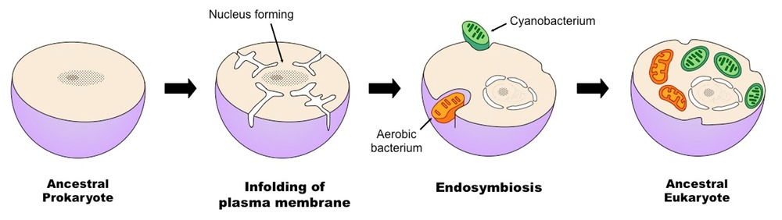
The origin of eukaryotic cells can be explained by the endosymbiotic theory.
Development of the Nucleus
A prokaryote grows in size and develops folds in it’s membrane to maintain an efficient SA:Vol
The infoldings are pinched off forming an internal membrane
The nucleoid region is enclosed in the internal membrane and hence becomes the nucleus
http://ib.bioninja.com.au/options/option-d-evolution-2/d1-origins-of-life-on-earth.html

Slide 36
The origin of eukaryotic cells can be explained by the endosymbiotic theory.
An endosymbiont is a cell which lives inside another cell with mutual benefit
The development of chloroplasts would be a very similar process except the benefit to the cell would be glucose/starch instead of ATP
Development of Mitochondria
An aerobic proteobacterium enters a larger anaerobic prokaryote (possibly as prey or a parasite)
It survives digestion to become a valuable endosymbiont*
The aerobic proteobacterium provides a rich source of ATP to it’s host enabling it to out-compete other anaerobic prokaryotes
As the host cell grows and divides so does the aerobic proteobacterium therefore subsequent generations automatically contain aerobic proteobacterium.
The aerobic proteobacterium evolves and is assimilated and to become a mitochondrion.
http://ib.bioninja.com.au/options/option-d-evolution-2/d1-origins-of-life-on-earth.html

Slide 37
The origin of eukaryotic cells can be explained by the endosymbiotic theory.
Evidence for Endosymbiosis
Mitochondria and chloroplasts are both organelles suggested to have arisen via endosymbiosis
Evidence that supports the extracellular origins of these organelles can be seen by looking at certain key features:
Membranes (double membrane bound)
Antibiotics (susceptibility)
Division (mode of replication)
DNA (presence and structural composition)
Ribosomes (size)
Mnmemonic: MAD DR (mad doctor)

Slide 38
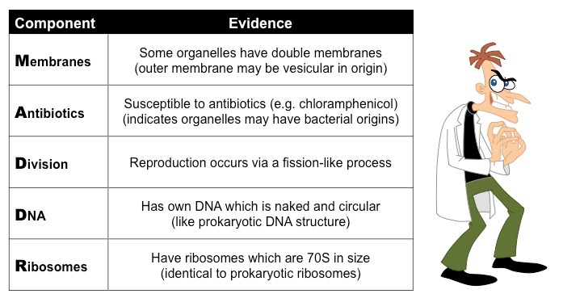
The origin of eukaryotic cells can be explained by the endosymbiotic theory.
The evidence supporting the endosymbiotic theory for mitochondria and chloroplasts:

Slide 39
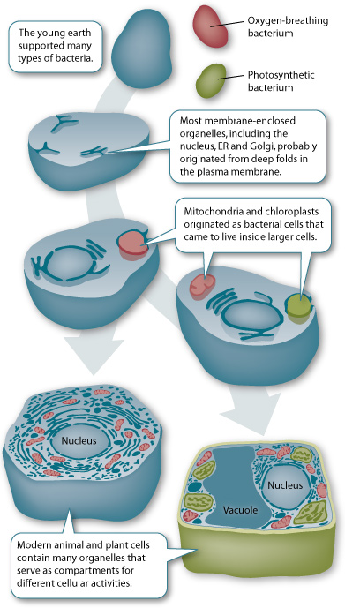
The origin of eukaryotic cells can be explained by the endosymbiotic theory.
The evidence supporting the endosymbiotic theory for mitochondria and chloroplasts:
They have their own DNA (which is naked and circular)
They have ribosomes that are similar to prokaryotes (70S)
They have a double membrane and the inner membrane has proteins similar to prokaryotes
They are roughly the same size as bacteria and are susceptible to the antibiotic chloramphenicol
They transcribe their DNA and use the mRNA to synthesize some of their own proteins.
They can only be produced by division of pre-existing mitochondria and chloroplasts.
http://sites.roosevelt.edu/mbryson/files/2011/11/endosymbiosis.jpg

Slide 40
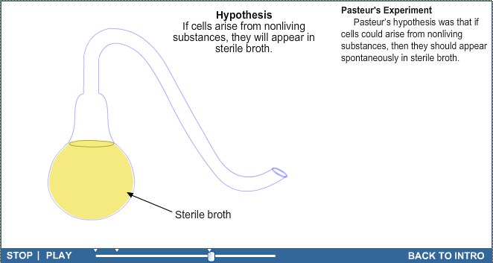
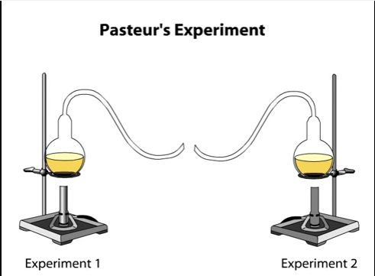
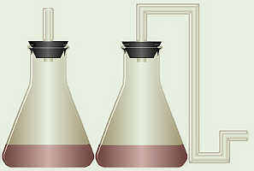
Evidence from Pasteur’s experiments that spontaneous generation of cells and organisms does not now occur on Earth.
Use the tutorials to learn about Pasteur’s experiment.
http://www.sumanasinc.com/webcontent/animations/content/scientificmethod.html
Repeat Pasteur’s experiment and see the results for yourself.
https://youtu.be/Xc-hHhDID9A
http://biologyjunction.com/pasteur_experiment.htm

Slide 41
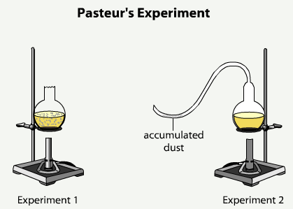
Evidence from Pasteur’s experiments that spontaneous generation of cells and organisms does not now occur on Earth.
Louis Pasteur designed an experiment to test whether sterile nutrient broth could spontaneously generate microbial life.
Results:
The broth in experiment 1 turned cloudy whilst the broth in experiment 2 remained clear.
This indicates that microbe growth only occurred in experiment 1.
Method:
Two experiments were setup
In both, Pasteur added nutrient broth to flasks and bent the necks of the flasks into S shapes
Each flask was then heated to boil the broth in order than all existing microbes were killed.
After the broth had been sterilized, Pasteur broke off the swan necks from the flasks in Experiment 1, exposing the nutrient broth within them to air from above.
The flasks in Experiment 2 were left alone.
Conclusion: Pasteur rejected the hypothesis of spontaneous generation as for growth of microbes to occur a source of contamination was needed.
Q – was Pasteur correct, could spontaneous generation of life never occur?
http://bcs.whfreeman.com/thelifewire/content/chp03/0302003.html

